Slide 1
Data Structure -Stack
Prepared By Mr . Venkatesh H

Slide 2
Stack
Stack is a linear data structure which follows a particular order in which the operations are performed.
The order may be LIFO(Last In First Out) or FILO(First In Last Out).
Mainly the following three basic operations are performed in the stack:
Push: Adds an item in the stack. If the stack is full, then it is said to be an Overflow condition.
Pop: Removes an item from the stack. The items are popped in the reversed order in which they are pushed. If the stack is empty, then it is said to be an Underflow condition.
Peek or Top: Returns top element of stack.
isEmpty: Returns true if stack is empty, else false.

Slide 3
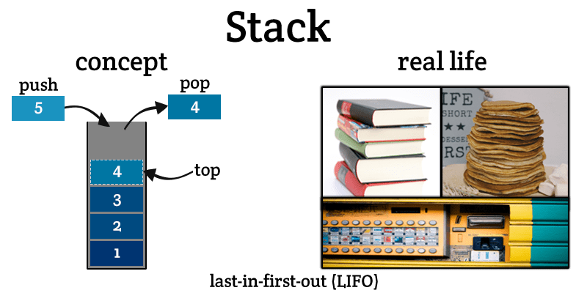
Stack

Slide 4
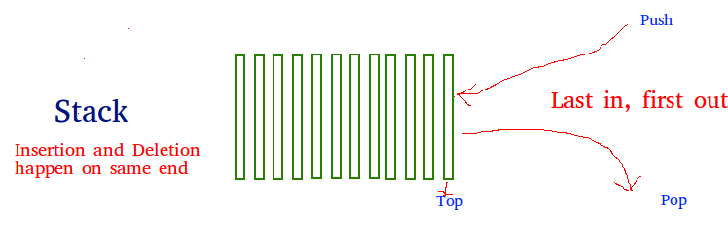
Continue…

Slide 5
Continue…
How to understand a stack practically?
There are many real-life examples of a stack.
Consider the simple example of plates stacked over one another in a canteen. The plate which is at the top is the first one to be removed, i.e. the plate which has been placed at the bottommost position remains in the stack for the longest period of time. So, it can be simply seen to follow LIFO/FILO order.

Slide 6
Continue…
Implementation:
There are two ways to implement a stack:
Using array
Using linked list

Slide 7
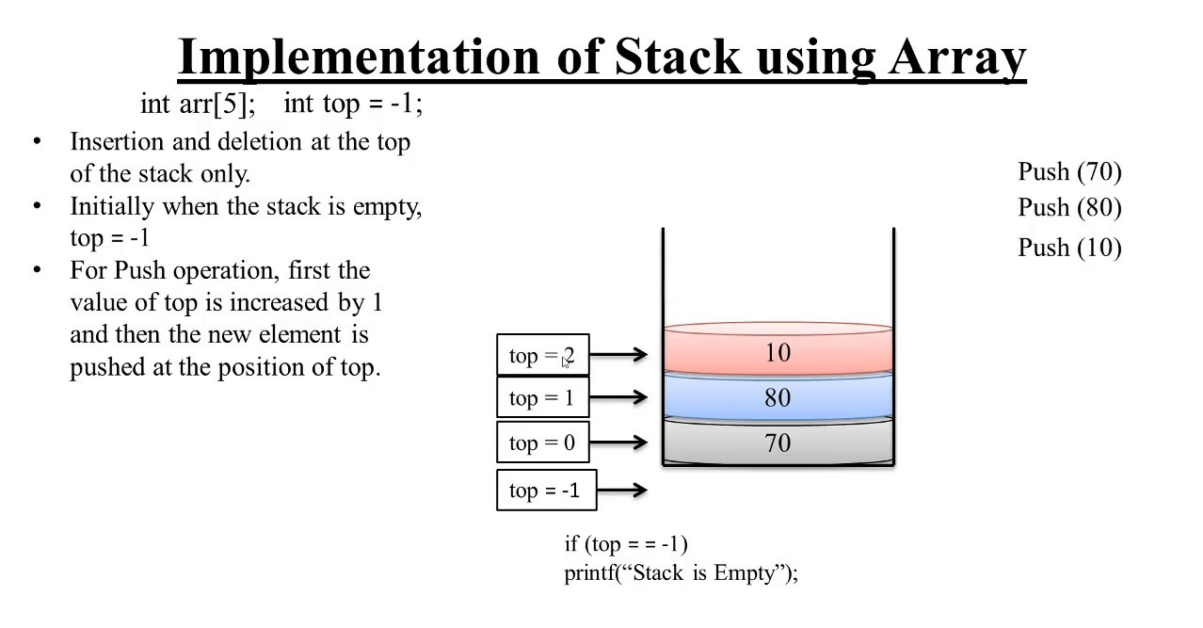
Continue…

Slide 8
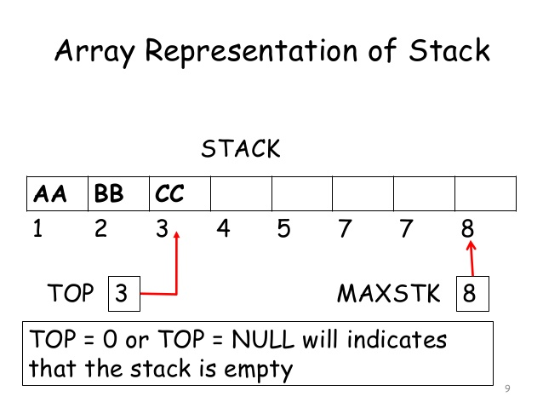
Array representation of stacks

Slide 9
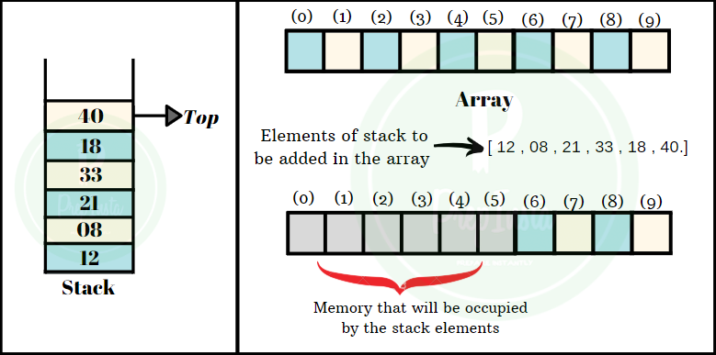
Array representation of stacks

Slide 10
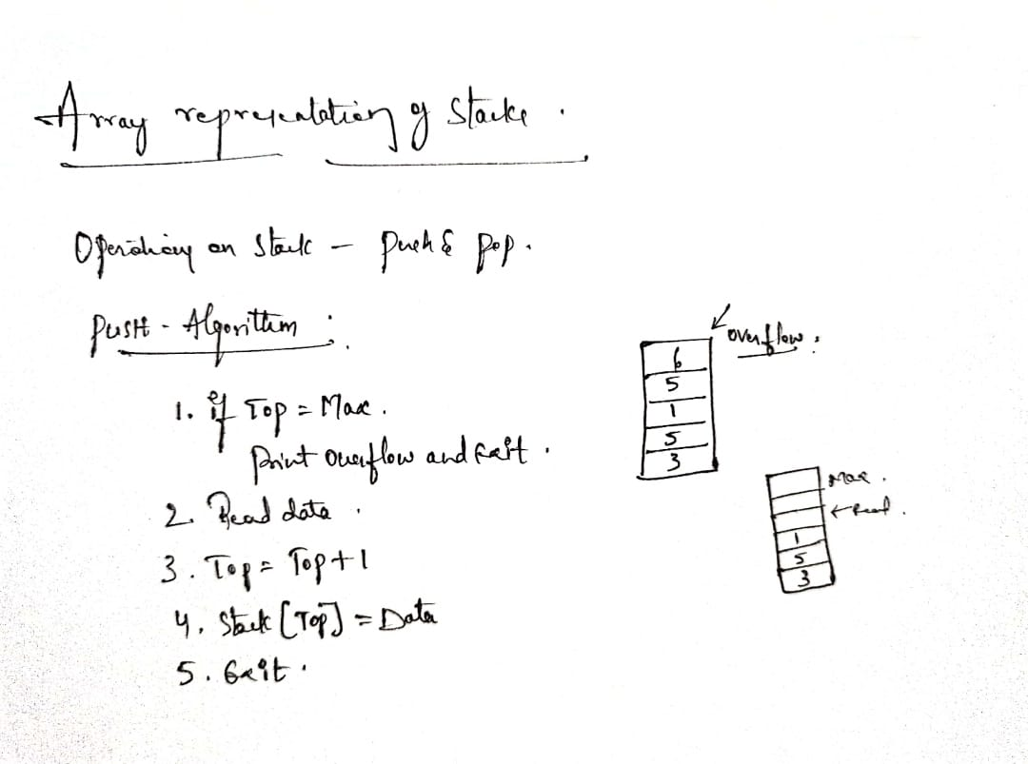
Algorithm - PUSH

Slide 11
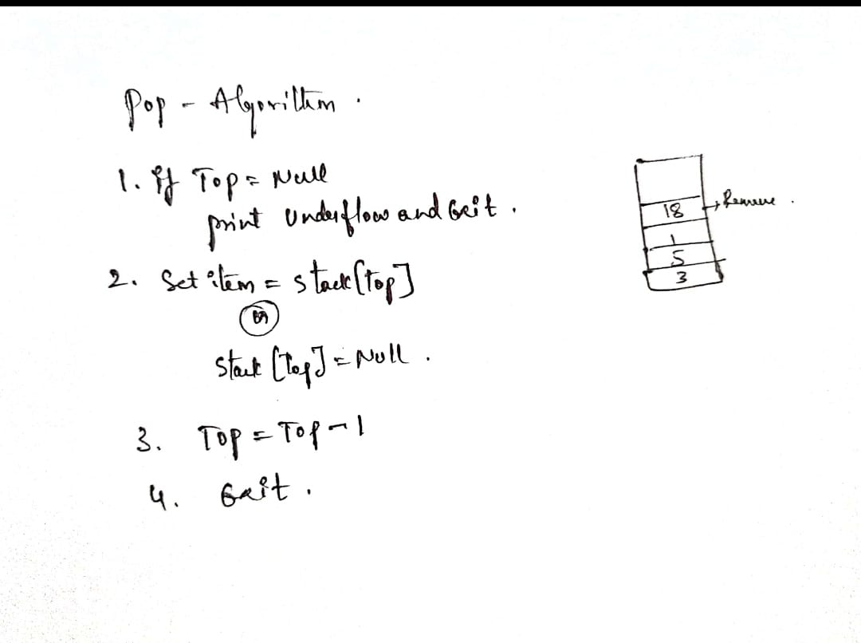
Algorithm - POP

Slide 12
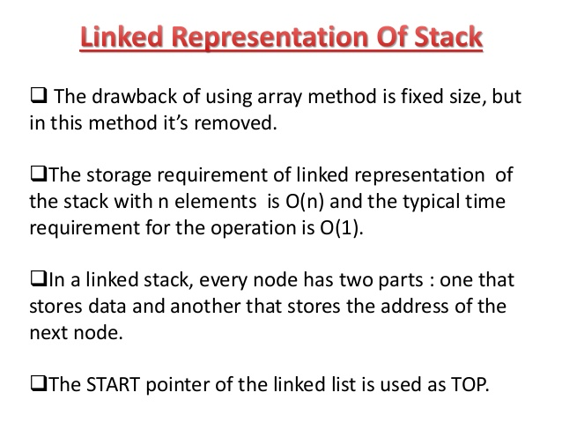
Linked representation of stacks

Slide 13
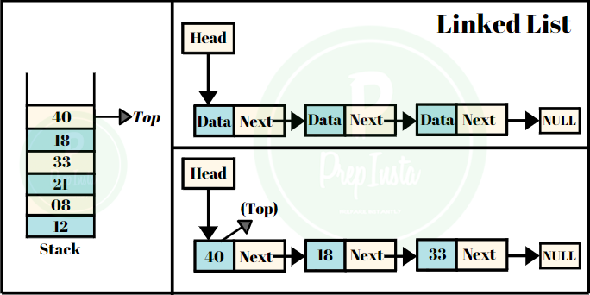
Continue…

Slide 14
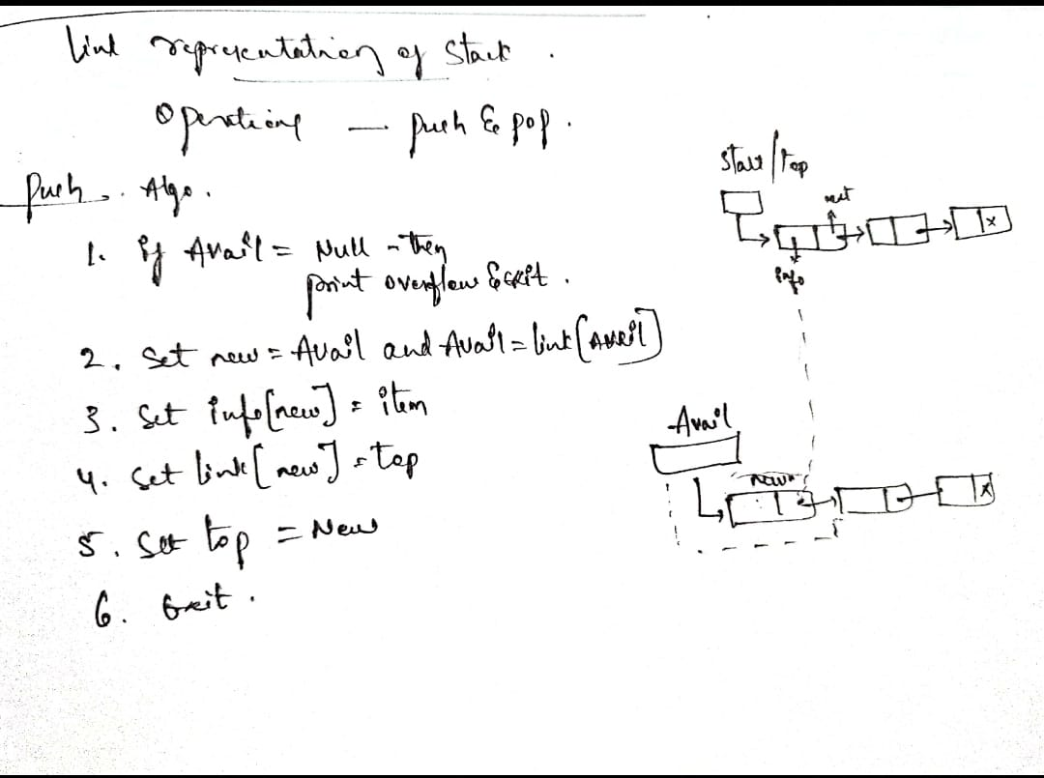
Algorithm - PUSH
Algorithm: PUSH(INFO, LINK, TOP, ITEM, AVAIL)
This algorithm pushes an element to the top of the stack
Step 1: If AVAIL==NULL, then Write: ‘OVERFLOW’ Return
Step 2: Set NEW=AVAIL and AVAIL = AVAIL->LINK
Step 3: Set NEW->INFO =ITEM
Step 4: Set NEW->LINK=TOP Set TOP=NEW
Step 5: EXIT

Slide 15
Algorithm - POP
Algorithm: POP(INFO, LINK, TOP, AVAIL, ITEM)
This algorithm deletes an element from the top of the stack
Step 1: If TOP==NULL , then: Write: ‘UNDERFLOLW’ AND Exit
Step 2: Set ITEM = TOP->INFO
Step 3: Set TEMP = TOP AND TOP= TOP->LINK
Step 4: TEMP->LINK = AVAIL AND AVAIL = TEMP
Step 5: EXIT

Slide 16
Stack as ADT
The abstract datatype is special kind of datatype, whose behavior is defined by a set of values and set of operations. The keyword “Abstract” is used as we can use these datatypes, we can perform different operations. But how those operations are working that is totally hidden from the user. The ADT is made of with primitive datatypes, but operation logics are hidden.
Here we will see the stack ADT. These are few operations or functions of the Stack ADT.
isFull(), This is used to check whether stack is full or not
isEmpry(), This is used to check whether stack is empty or not
push(x), This is used to push x into the stack
pop(), This is used to delete one element from top of the stack
peek(), This is used to get the top most element of the stack
size(), this function is used to get number of elements present into the stack

Slide 17
Arithmetic expression Polish notation
Polish notation is a notation form for expressing arithmetic, logic and algebraic equations. Its most basic distinguishing feature is that operators are placed on the left of their operands. If the operator has a defined fixed number of operands, the syntax does not require brackets or parenthesis to lessen ambiguity.
Polish notation is also known as prefix notation, prefix Polish notation, normal Polish notation, Warsaw notation and Lukasiewicz notation.

Slide 18
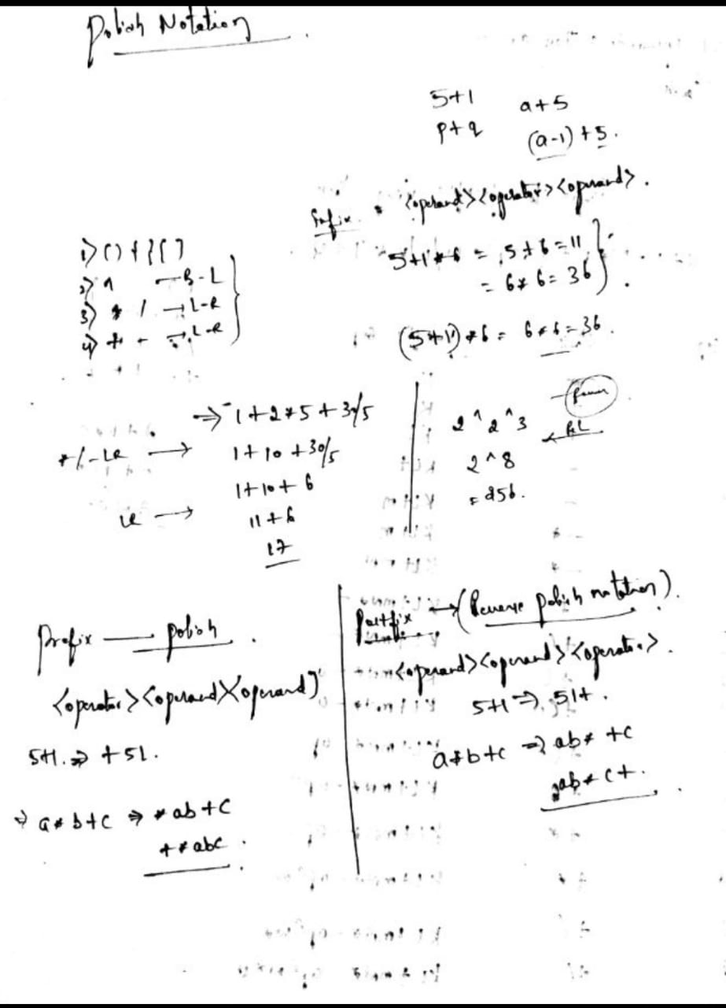
Arithmetic expression Polish notation

Slide 19
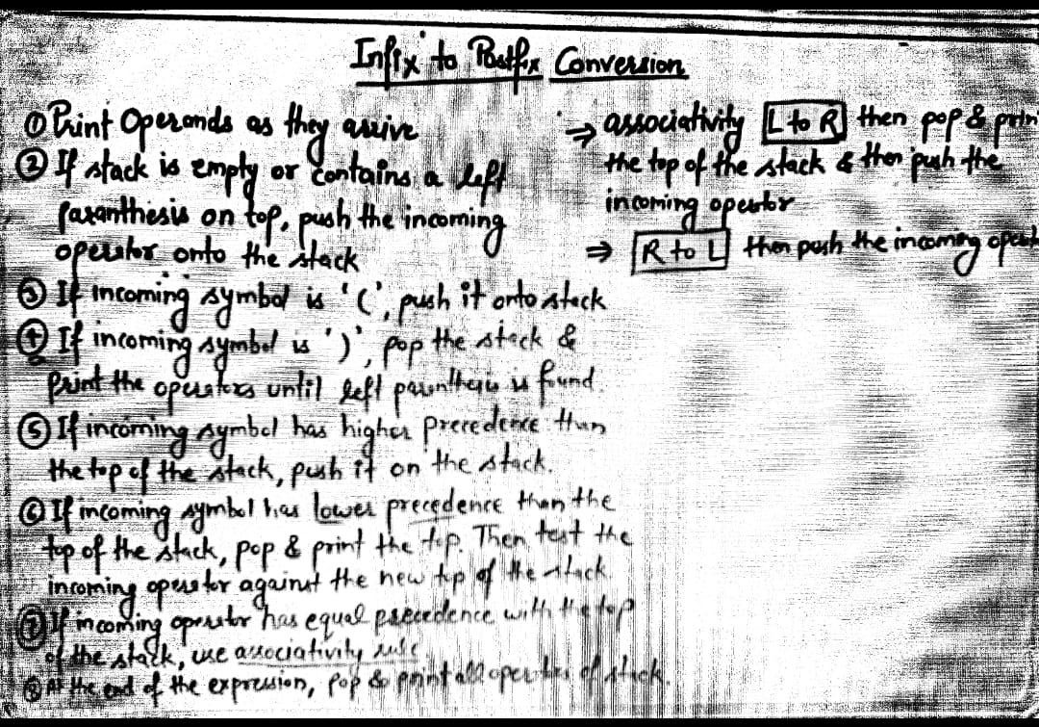
Rules

Slide 20
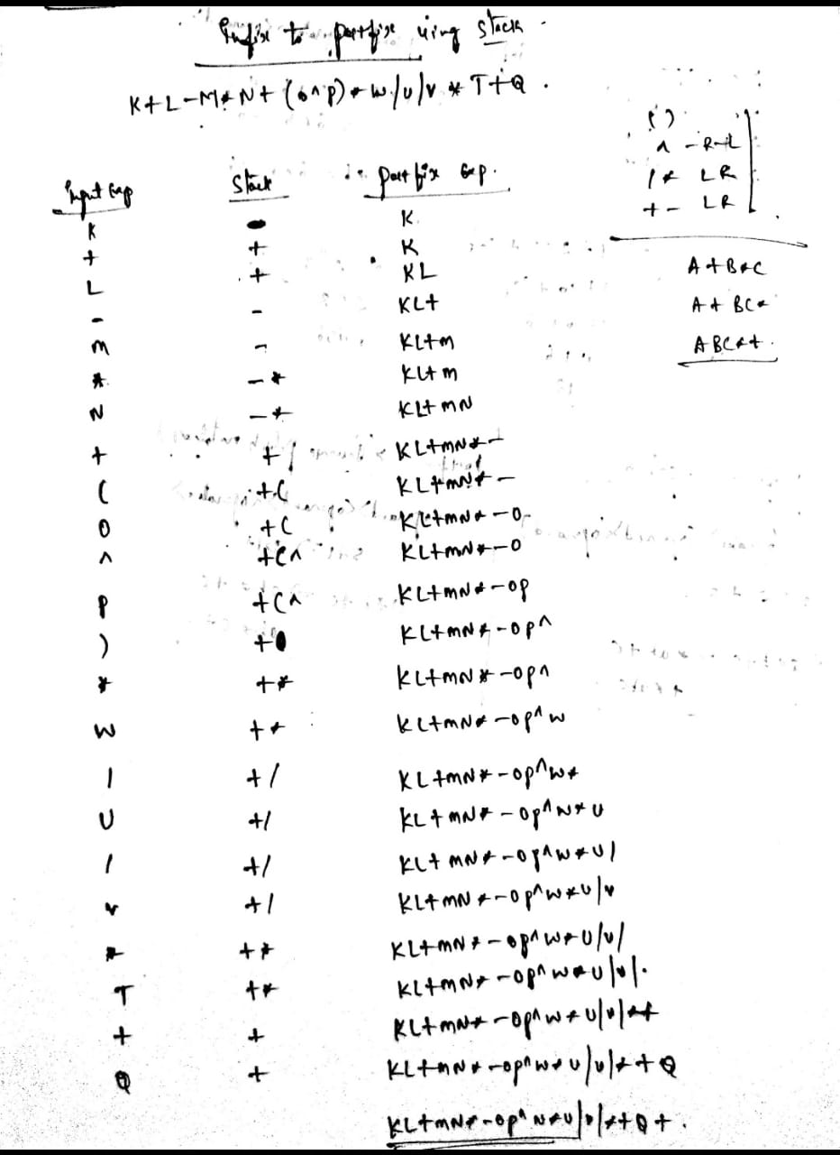
Infix to postfix conversion

Slide 21
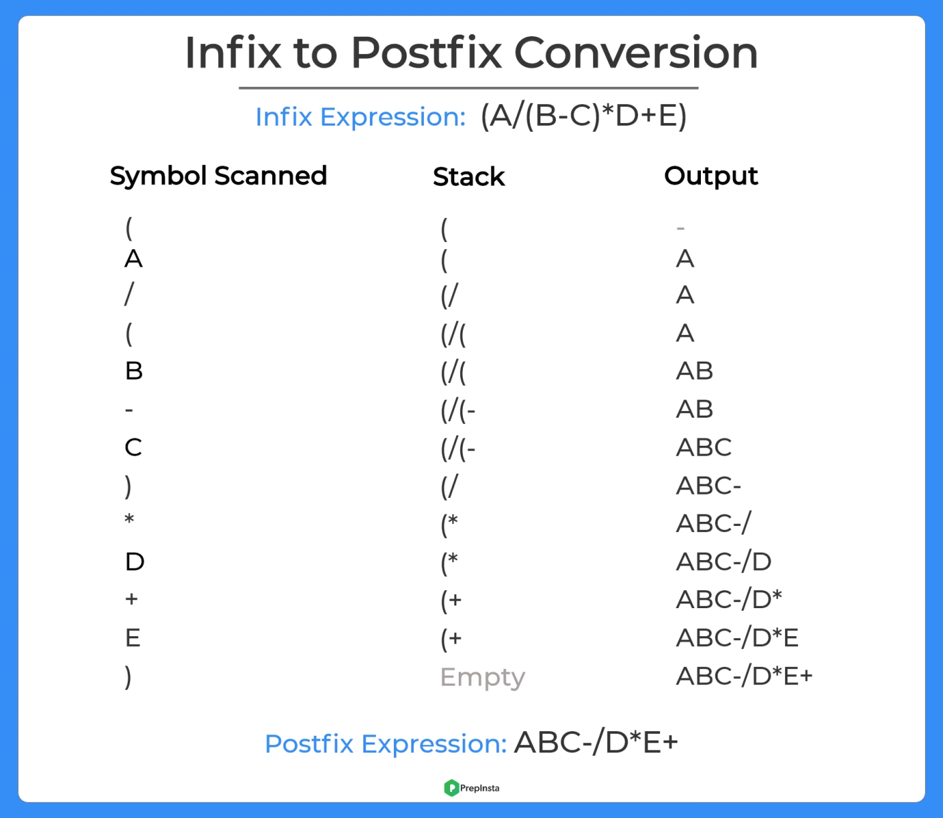
Continue…

Slide 22
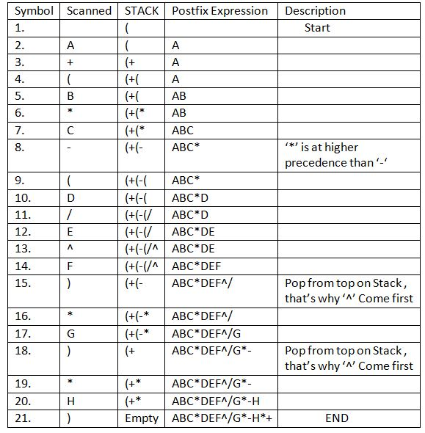
Infix to postfix conversion
A+ (B*C-(D/E^F)*G)*H

Slide 23
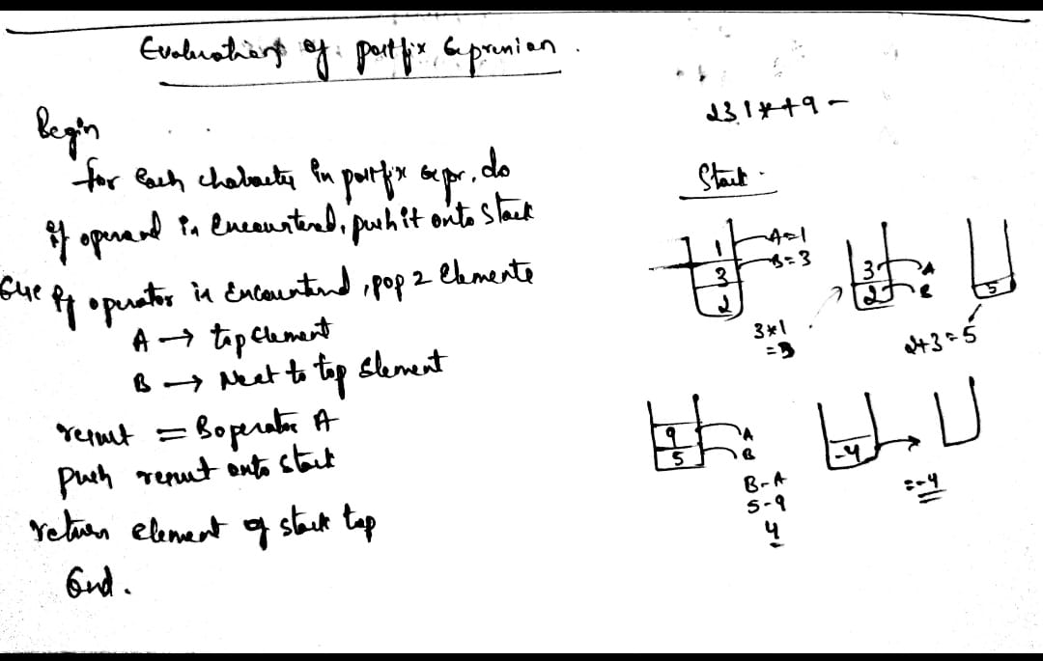
Evaluation of postfix expression

Slide 24
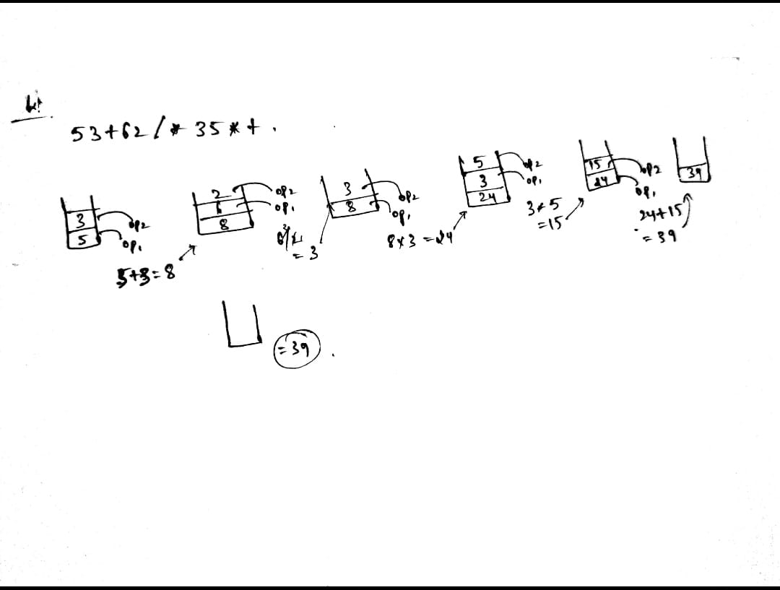
Continue…

Slide 25
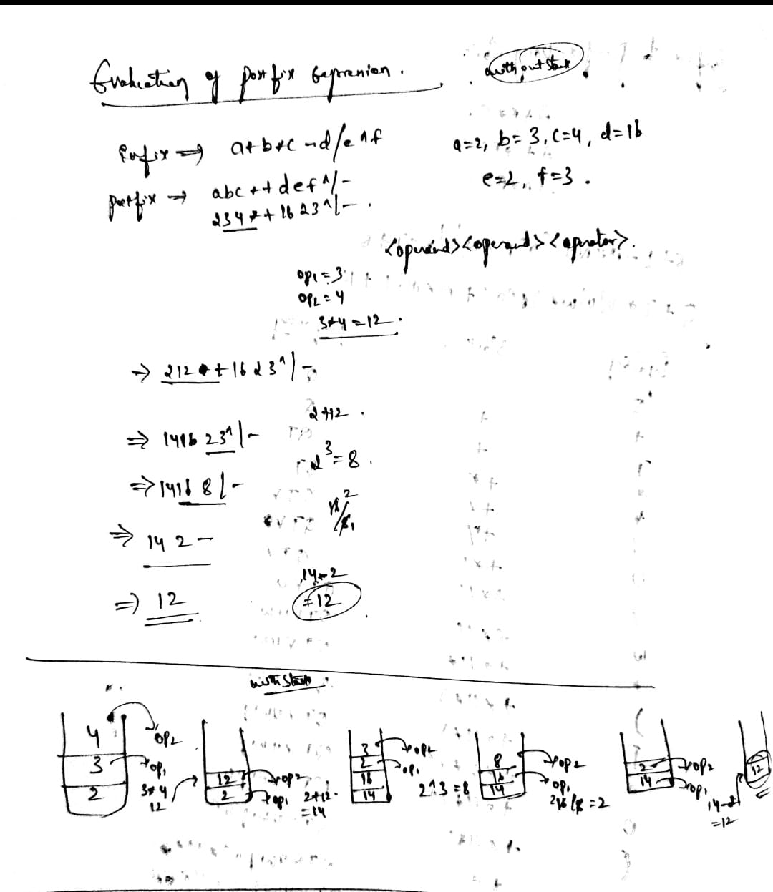
Continue…

Slide 26
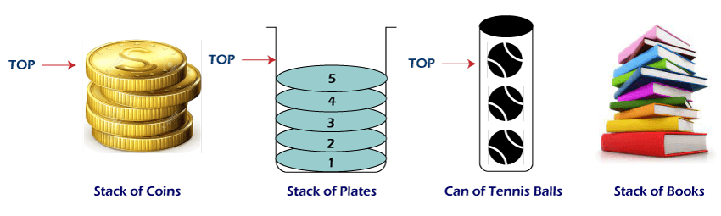
Applications of Stack

Slide 27
Application of the Stack
A Stack can be used for evaluating expressions consisting of operands and operators.
Stacks can be used for Backtracking, i.e., to check parenthesis matching in an expression.
It can also be used to convert one form of expression to another form.
It can be used for systematic Memory Management.

Slide 28
Continue…
Following is the various Applications of Stack in Data Structure:
Evaluation of Arithmetic Expressions
Backtracking
Delimiter Checking
Reverse a Data
Processing Function Calls

Slide 29
Recursion
What is Recursion?
The process in which a function calls itself directly or indirectly is called recursion and the corresponding function is called as recursive function. Using recursive algorithm, certain problems can be solved quite easily. Examples of such problems are Towers of Hanoi (TOH), Inorder/Preorder/Postorder Tree Traversals, DFS of Graph, etc.

Slide 30
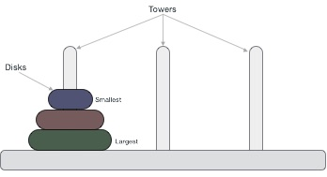
Tower of Hanoi
Tower of Hanoi, is a mathematical puzzle which consists of three towers (pegs) and more than one rings is as depicted
These rings are of different sizes and stacked upon in an ascending order, i.e. the smaller one sits over the larger one. There are other variations of the puzzle where the number of disks increase, but the tower count remains the same.

Slide 31
Rules
Rules
The mission is to move all the disks to some another tower without violating the sequence of arrangement. A few rules to be followed for Tower of Hanoi are −
Only one disk can be moved among the towers at any given time.
Only the "top" disk can be removed.
No large disk can sit over a small disk.

Slide 32
Tower of Hanoi

Slide 33
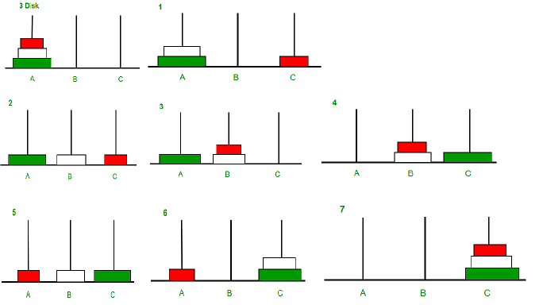
Continue…

Slide 34
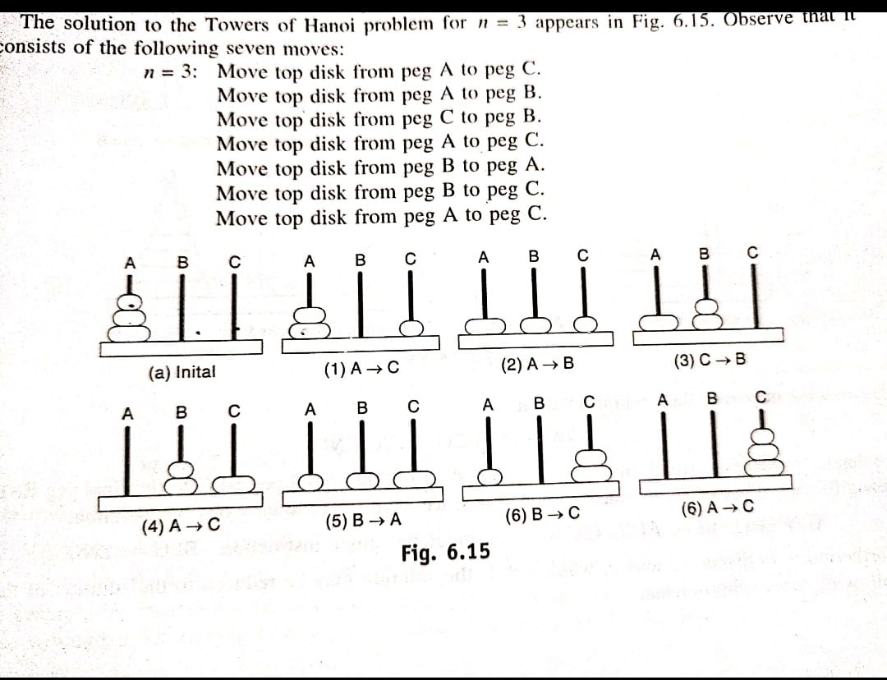
TOH

Slide 35
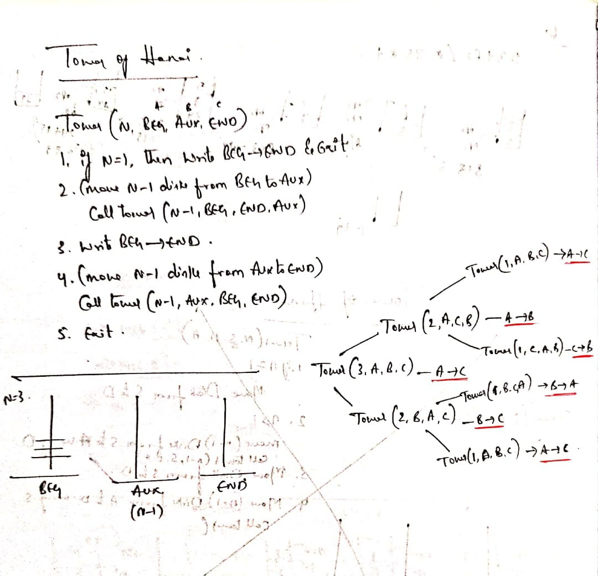
Algorithm - TOH

